Slide 1
Cooperative Economy:
The Impact of the Highly Improbable
Mario Hébert, Director Public Affairs , Fondaction CSN
Delta Beauséjour, Moncton, N.B., February 29, 2012

Slide 2
Plan
Brief Return On The CRISIS
Ways For Cooperatives
The 12 Labors of COOP Hercules

Slide 3

Brief Return on the CRISIS
Multiple Facets
Financial and Economic
Ecology
Food
Climate
Governance

Slide 4

Brief Return on the CRISIS
Even Davos Has Doubt on Capitalism…
The Model will Die Out if there is no Reform.
«If we do not act quickly, when we meet here [at Davos] in three or four years, the type of capitalism that many of us have known and that we believed to be the best form of capitalism, has lived».
David M. Rubenstein, co-director, Carlyle Investment Group
Thursday, january 26, 2012

Slide 5

Ways for Cooperatives
Rethinking Finance
Reducing inequalities
Jump on the SD Bandwagon
« Responsible » buying and consumption
Promoting another governance

Slide 6

Rethinking Finance
Regulating Financial Sector!
Stop Focus on short term yields
Back to the basics
Socially Responsible Finance
Re-connecting Finance to Real Economy
Targeting Reasonable Yields – Mid-to-Long Term
Transparency in Governance/ Salaries and Bonuses
BE AUDACIOUS and GIVE SENSE TO MONEY

Slide 7
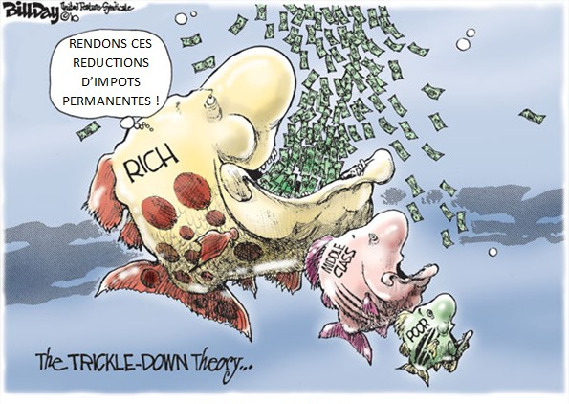
Reducing Inequalities
Most Important Risk Faced by Democracies
Better Wealth Distribution
Accesible Education and Training Programs
Reinvent Welfare State
Syndicalism et Social / Communauty Activism
Cooperatives Values and Principles
Re-balancing « Liberty - Equality - Fraternity »

Slide 8

Jump on the SD Bandwagon
Rethinking Growth
  « Brown » Economy = NO
  « Green » Economy = YES
Cooperatives and SD
Pioneer : Fair Trade, Organic Food, Renewable Energy, « Soft » Transportation, Solidarity Tourism, Open Source, ie.
But «Where’s Charlie» of SD; Where’s Environment?

Slide 9
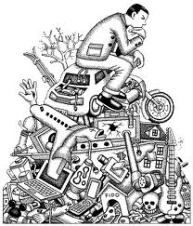
«Responsible» Consuming
From Looking to Being
« Most Important Challenge Ever Face » (T. Jackson)
Rethinking our Relation to Objects
Intervene on Social, Psychological and Material Aspects
Educate, Informe, Sensibilize
Walk the Talk

Slide 10
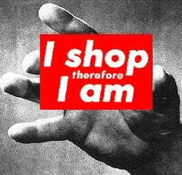
«Responsible» Consuming
«Our enormously productive economy demands that we make consumption our way of life, that we convert the buying and use of goods into rituals, that we seek our spiritual satisfactions, our ego satisfactions, in consumption… The greater the pressures upon the individual to conform to safe and accepted social standards, the more does he tend to express his aspirations and his individuality in terms of what he wears, drives, eats- his home, his car, his pattern of food serving, his hobbies. .»
Victor Lebow, "The Real Meaning of Consumer Demand“ (1955)

Slide 11
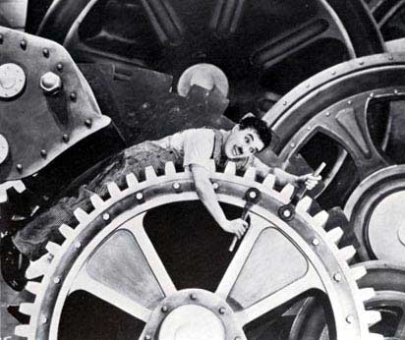
Promoting Another Governance
Take Advantage of Demography
Issue of Business Succession
Right at the Heart of the Beast
Workers Coops and WCS
New Business Model
Employee Becomes Owner
Participatory Management

Slide 12

12 Labours of COOP Hercules
Service general interest
Develop a speech on economy
Present ourselve as an alternative to the dominant model.
et. Plural Economy or Entrepreneurship Biodiversity
1.Society
Project

Slide 13
12 Labours of COOP Hercules
No alternative without an alternative theory
Rediscover Proudhon, Gide, Desroches et Vianney
Multidisciplanary academic research with partnership between enterprises and universities
2. Theorical
framework

Slide 14
12 Labours of COOP Hercules
Be careful of the Iron-Cage syndrom or institutional isomorphism
Be different in developing our own standards
3. COOP
Modus
operandi
« Insanity: doing the same thing over and over again and expecting different results » (Albert Einstein)

Slide 15
12 Labours of COOP Hercules
Economy + social = COOP
Economy + social + environment = SD
Waiting for the 8th cooperative principle?
4. SD
Carrier

Slide 16
12 Labours of COOP Hercules
Develop credible speakers
Having something original to say
Position coop movement on the major challenges facing society
Mastering the medias
5.Mastering
The art of
communication

Slide 17
12 Labours of COOP Hercules
Understand and master these new communication tools
Exploit the opportunities created by social medias
Step in open source softwares
6. Web 2.0
and
social medias

Slide 18
12 Labours of COOP Hercules
Bring together the dispersed
Understand and practice real networking
Create alliances
Be welcoming and respectful of diversity
Give meaning
7. Sparsa
Colligo*

Slide 19
12 Labours of COOP Hercules
Stop playing ostrich
Elaborate a political program
Submit it to political parties
Promote it
8. Taming
politics

Slide 20
12 Labours of COOP Hercules
Gen X, Y, (Z) : three visions and three realities
Create an intergenerational dynamic
Involve youths at all levels (orientation as well as decision)
9. Make way
for youths

Slide 21
12 Labours of COOP Hercules
To differentiate coops
Make it a real proof
Be open to critics and adapt permanently
Never be paralysed by perfection
10. Walk
the talk

Slide 22
12 Labours of COOP Hercules
We can change the world
On a volontary basis
Without dogmatism
Being respectful of diversity
11. Believe in

Slide 23
12 Labours of COOP Hercules
When a system is not able to solve the problems that he met with, it has to metamorphose itself to a richer system
How this metamorphosis operates?
"You can never predict. The improbable often happens in history. Try to have a little faith in the improbable, but also try to act in his favor". Edgar Morin
12. black
Swan syndrom

Slide 24
Conclusion
Ne doutons jamais qu’un petit groupe d’individus conscients et engagés puissent changer le monde. C’est même de cette manière que cela s’est toujours produit.
Margaret Mead
Caminante no hay camino, se hace el camino al andar
Antonio Machado
(“Travelers, there is no path, paths are made by walking.” )

